Slide 1


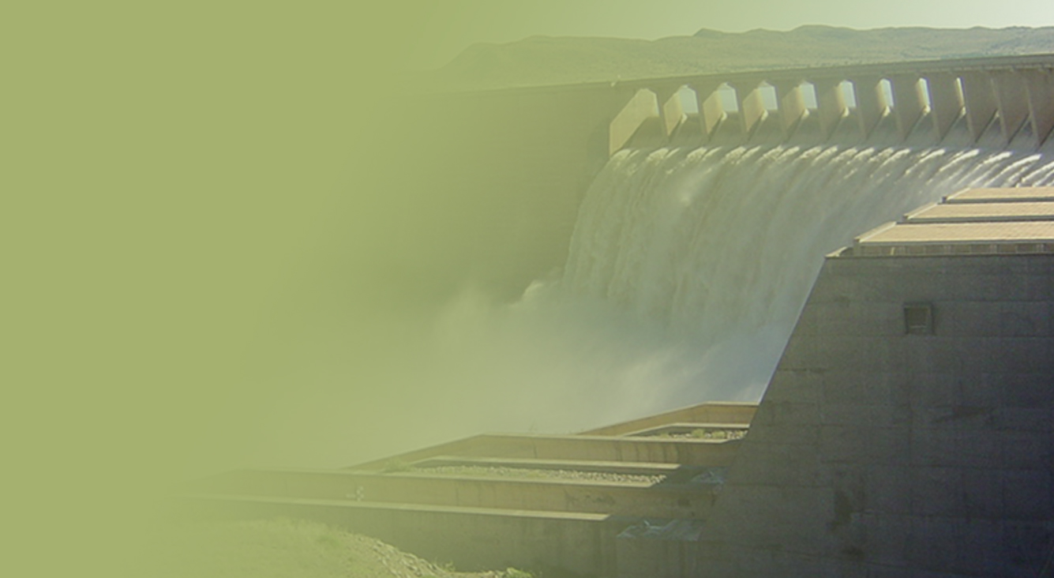
The Determination of Water Resources Classes and Resource Quality Objectives in the Breede-Gouritz WMA
TTG 2
Presented by: Barry Clark
Date: 12 March 2018
Venue: Graham and Rhona Beck Skills Centre, Robertson

Slide 2
Study Objectives
  Determine Water Resource Classes (WRCs)
  Determine Resource Quality Objectives (RQOs)
  Support Gazetting of Recommended Water Resources Classes and RQOs

Slide 3
Meeting Objectives
Present the methodology followed to prioritise Resource Units
Present the methodology followed to evaluate Resource Units
Present the draft Resource Quality Objectives for Resource Units

Slide 4
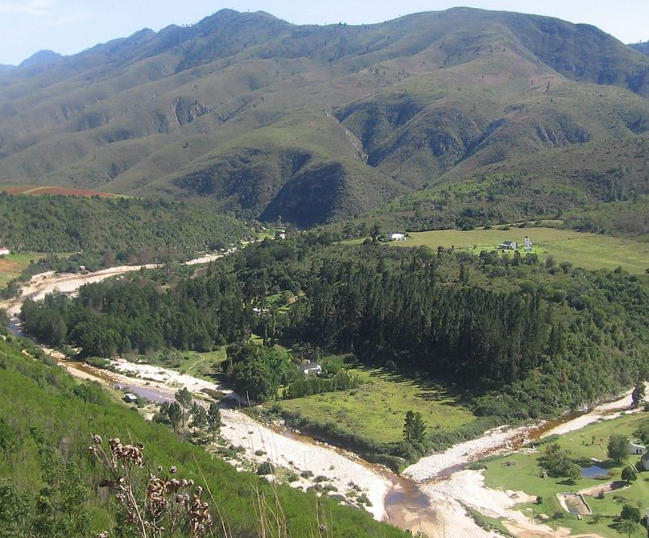

Overview of Study Progress

Slide 5
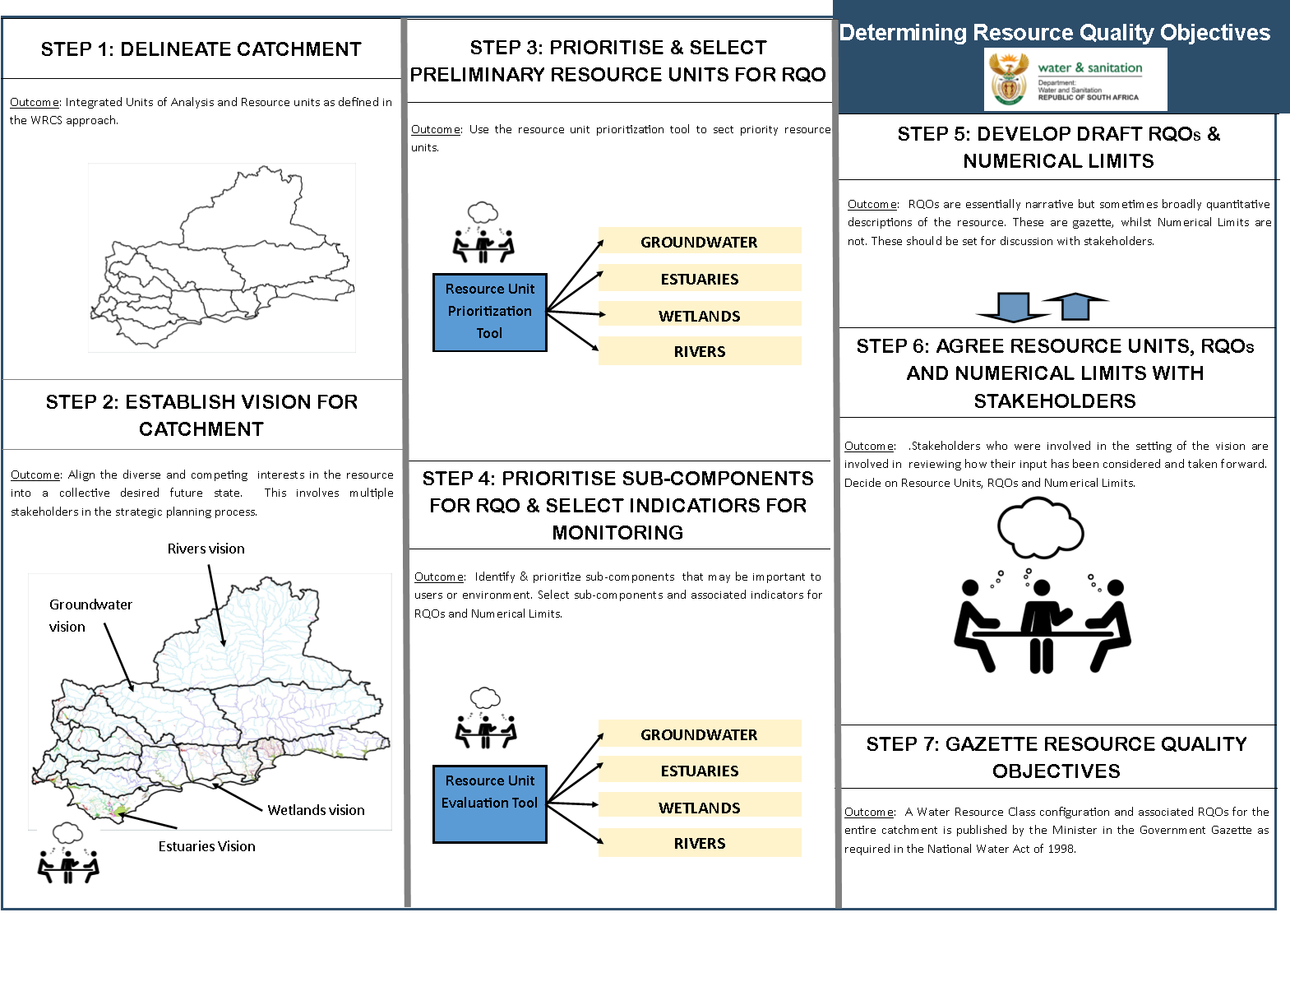
Study Status
DAMS
Draft
Complete
Draft
Complete
DAMS
Draft
Notes:
Erik to present progress, Reminder of two stage process (Classification followed be RQOs – but gazetted together). Link to RQOs? Then zoom in on the classification process

Slide 6
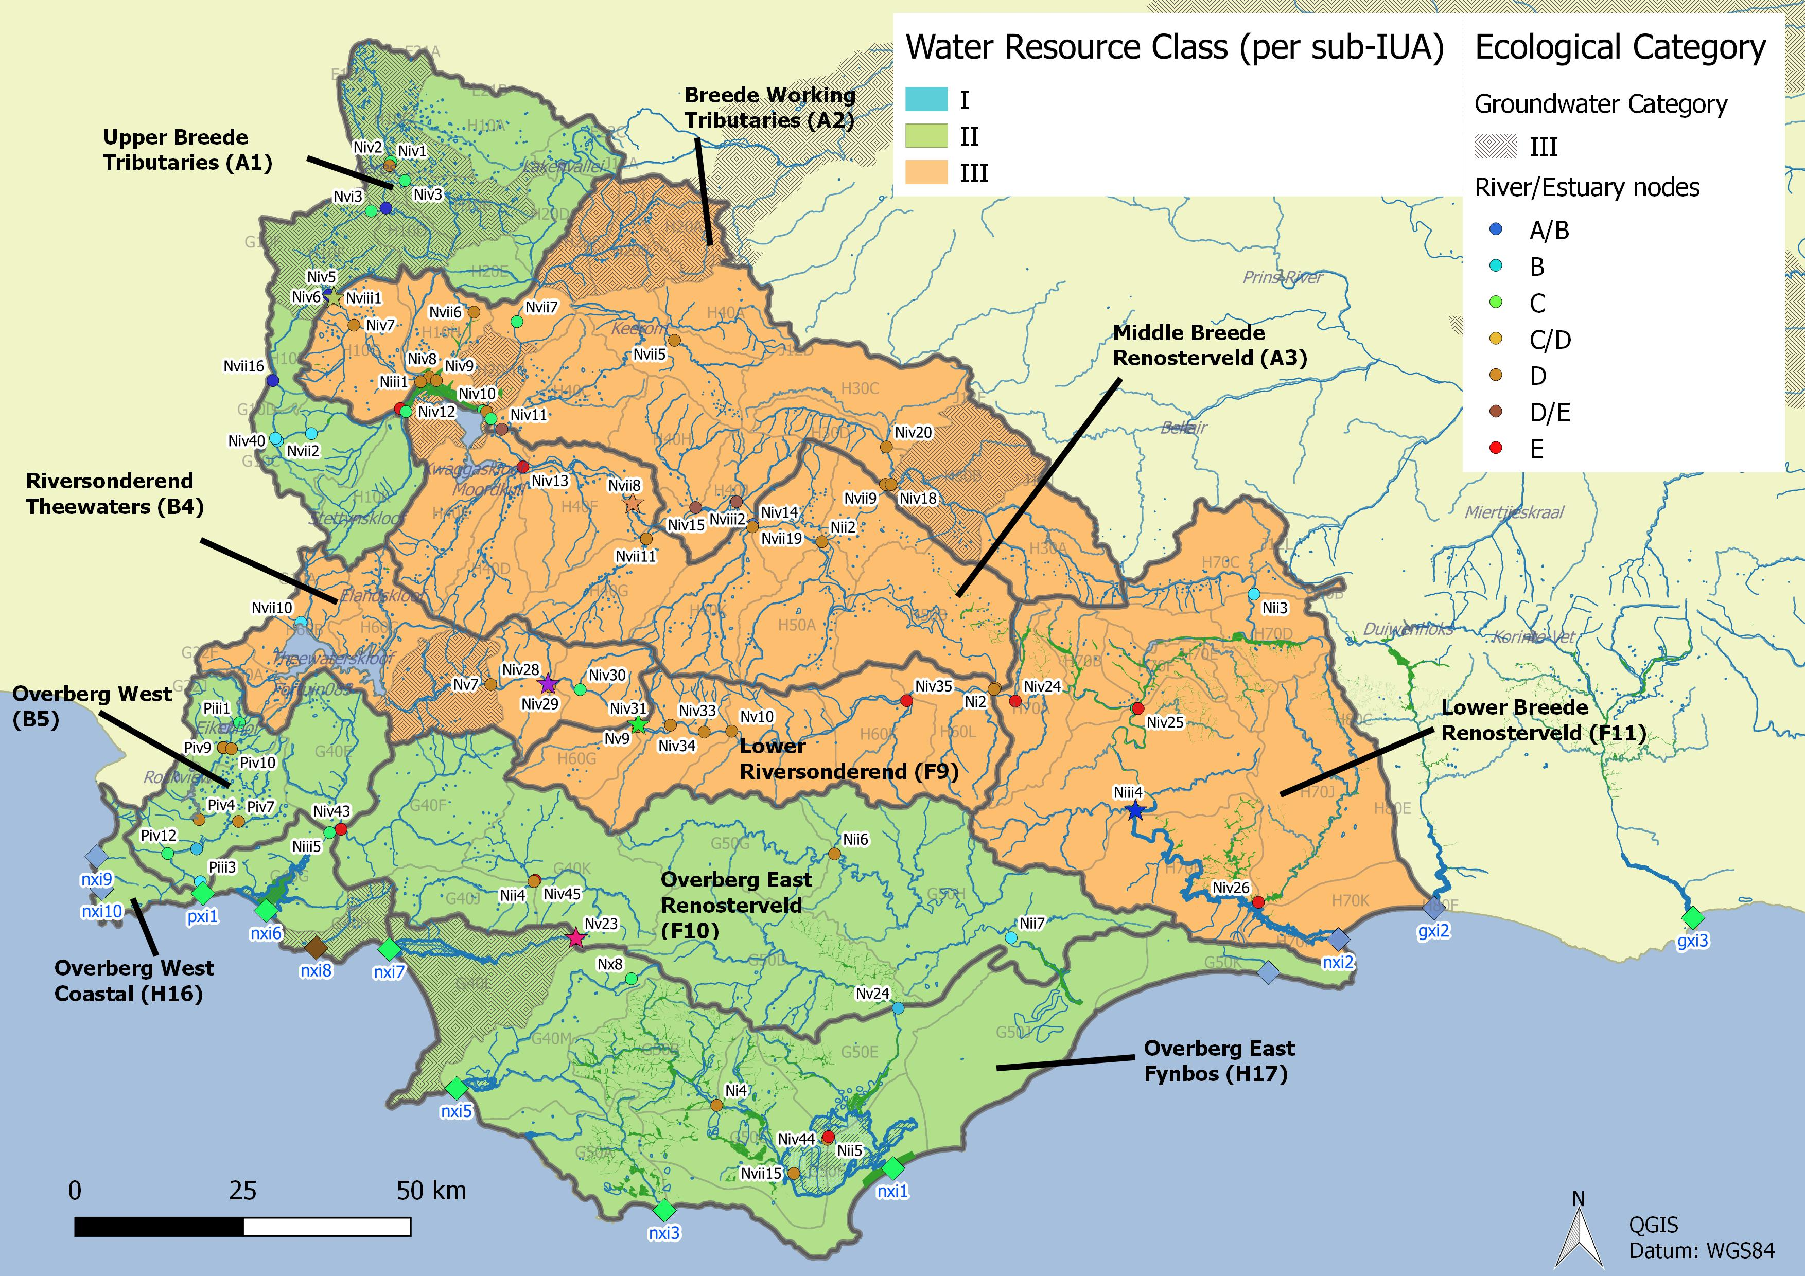
Integrated Units of Analysis and Nodes
Breede-Overberg Region

Slide 7
Breede-Overberg Region
Region | IUA | Spatially targeted
Breede Overberg | A1 Upper Breede Tributaries | II
 | A2 Middle Breede Renosterveld | III
 | A3 Breede Working Tributaries | III
 | B4 Riversonderend Theewaters | III
 | F9 Lower Riversonderend | III
 | B5 Overberg West | II
 | H16 Overberg West Coastal | II
 | F10 Overberg East Renosterveld | II
 | H17 Overberg East Fynbos | III
 | F11 Lower Breede Renosterveld | II

Slide 8
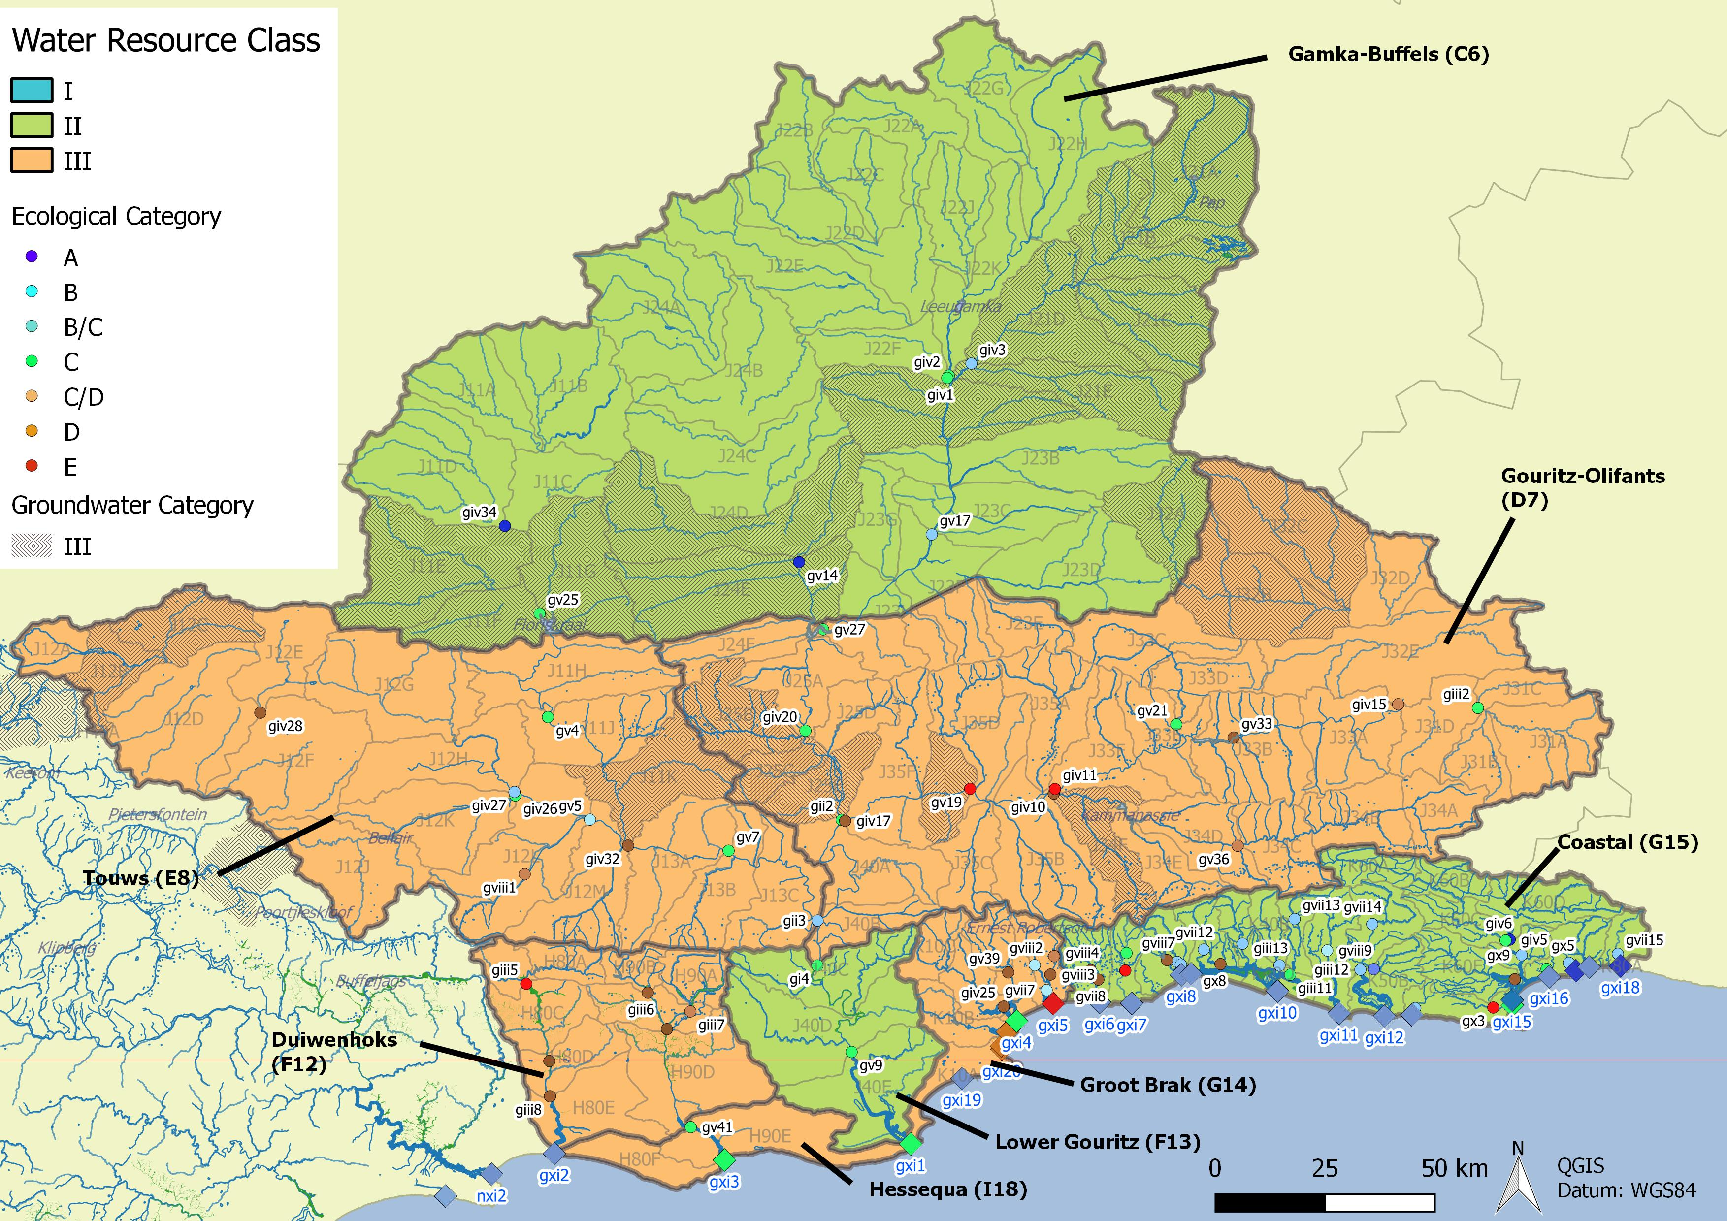
Integrated Units of Analysis and Nodes
Gouritz-Coastal Region

Slide 9
Gouritz-Coastal Region
Region | IUA |  | Spatially targeted
Gouritz Coastal | Gamka Buffels | C6 | II
 | Touws | E8 | III
 | Gouritz-Olifants | D7 | III
 | Lower Gouritz | F13 | II
 | Duiwenhoks | F12 | III
 | Hessequa | I18 | III
 | Groot Brak | G14 | III
 | Coastal | G15 | II

Slide 10
Determination of RQOs for estuaries in the Breede-Overberg area
Notes:
Erik and team to present the methodology used for scenario evaluation

Slide 11
Outline
Estuaries in the Breede-Overberg region
Prioritisation of estuaries for RQO development
Selection of indicators for monitoring
Numerical RQOs and narrative limits (examples)

Slide 12
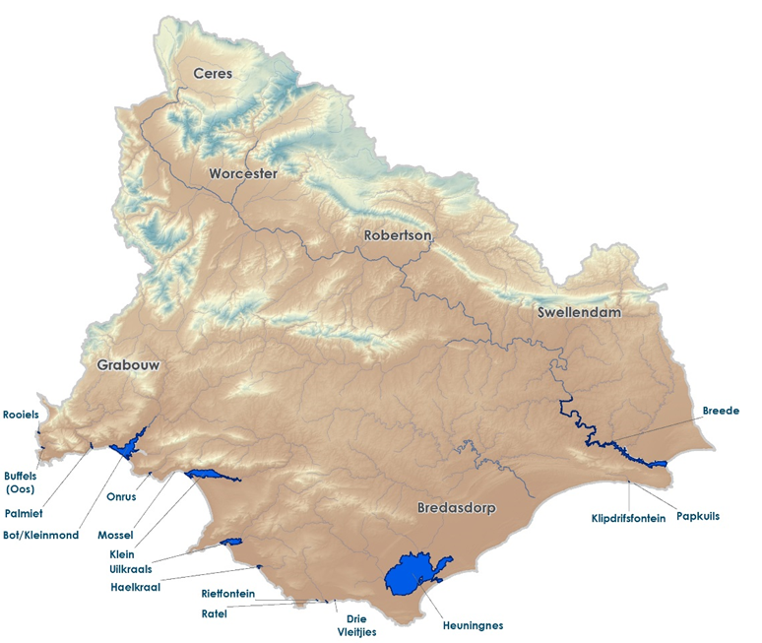
Estuaries in the Breede Overberg Region

Slide 13
Estuaries in the Breede-Overberg Region
Estuary | REC | Current |  | Target
 |  | PES | %nMAR | EC | %nMAR
Rooiels | B | B | 98.63 | B | 98.63
Buffels (oos) | B | B | 81.86 | B | 81.86
Palmiet | B | C | 70.13 | C | 70.13
Bot/Kleinmond | B | C | 81.78 | C | 81.78
Onrus | D | D | 51.77 | D | 51.77
Klein | B | C | 80.33 | C | 85.58
Uilkraals | C | E | 43.93 | C/D | 58.79
Ratel | C | C | 90.02 | C/D | 72.99
Klipdrifsfontein | A | A | 64.77 | A | 64.77
Heuningnes | A | C | 68.78 | A/B | 78.17
Breede | B | B | 49.53 | B | 47.19

Slide 14
Prioritisation of estuaries for RQO development
Priority estuaries were identified using two approaches:
  Estuary Importance Score (EIS) which is incorporated in the EWR methods for estuaries (initially completed in 2002 for all estuaries in SA, updated in numerous times thereafter)
  Resource Unit Prioritisation Tool (RUPT), published by DWA (2011)

Slide 15
Estuary Importance Score (EIS)
Criterion | Score (e.g.) | Weight
Size | 50 | 15
Zonal Type Rarity | 50 | 10
Habitat Diversity | 70 | 25
Biodiversity Importance | 88 | 25
Functional Importance | 60 | 25
ESTUARY IMPORTANCE SCORE = Weighted Mean | 70
Criteria for consideration | Guidelines for importance score
a Conduit for detritus, nutrients and sediments generated in the catchment to the sea | 0 none 20 little 40 some 60 important 80 very important 100 extremely important
b. Export of detritus and nutrients to the coastal zone generated within estuary
c. Nursery function for fish and crustaceans (marine and riverine)
d. Movement corridor for river invertebrates and fish breeding in marine environment (e.g. river crab Varuna litterata)
e. Roosting area for marine or coastal birds
Overall functional importance score | Max (a to e)

Slide 16
EIS Results
ESTUARY (West to East) | Plant | Invert | Fish | Bird | Biodiversity | Size | Habitat | Zonal Type Rarity | Importance Score* | Rank
Rooiels | 90 | 40 | 20 | 10 | 65.0 | 40 | 40 | 10 | 43.3 | 148
Buffels (Oos) | 100 | 50 | 30 | 10 | 73.5 | 50 | 30 | 10 | 46.9 | 134
Palmiet | 80 | 80 | 40 | 60 | 71.0 | 70 | 60 | 20 | 62.8 | 82
Bot/Kleinmond | 90 | 100 | 100 | 100 | 98.5 | 100 | 100 | 70 | 96.6 | 8
Onrus | 70 | 10 | 40 | 50 | 59.5 | 70 | 60 | 10 | 58.9 | 94
Klein | 100 | 100 | 100 | 100 | 100.0 | 100 | 100 | 70 | 97.0 | 5
Uilkraals | 90 | 80 | 40 | 90 | 82.0 | 80 | 90 | 10 | 76.0 | 47
Ratel | 10 | 40 | 20 | 70 | 52.0 | 40 | 10 | 10 | 32.5 | 191
Heuningnes | 100 | 90 | 60 | 80 | 90.5 | 90 | 90 | 20 | 83.1 | 24
Klipdrifsfontein | 10 | 30 | 10 | 60 | 43.5 | 10 | 10 | 10 | 18.4 | 237
Breë | 80 | 100 | 90 | 90 | 89.0 | 100 | 90 | 20 | 86.8 | 19

Slide 17
Resource Unit Prioritisation Tool (RUPT)
Provision of cultural services to society
Provision of supporting livelihoods of significant vulnerable communities
Importance in meeting strategic requirements and international obligations
Provision of supporting and regulating services
Contributing to the economy (GDP and job creation) in the catchment (e.g. commercial agriculture, industrial abstractions and bulk abstractions by water authorities)
Level of threat posed to users
EIS category
Present ecological status
Priority in provincial / fine scale aquatic biodiversity plans
Level of threat posed to ecological components of the estuary
Estuaries with PES lower than a D Category or lower than the accepted gazetted category
Availability of EWR site data or other monitoring data (RHP, DWS gauging weirs etc.)
Accessibility of resource unit for monitoring
Safety risk associated with monitoring RUs.

Slide 18
RUPT Results
 | Rooiels | Buffels (Oos) | Palmiet | Bot/Kleinmond | Onrus | Mossel | Klein | Uilkraals | Haelkraal | Rietfontein | Ratel | Drie Vleitjies | Heuningnes | Klipdrifsfontein | Papkuils | Breede
Position in IUA | 0.25 | 0.25 | 0.25 | 0.25 | 0.25 | 0.25 | 0.25 | 0.25 | 0.25 | 0.25 | 0.25 | 0.25 | 0.25 | 0.25 | 0.25 | 0.25
Concern for users | 0.01 | 0.01 | 0.07 | 0.17 | 0.20 | 0.00 | 0.24 | 0.06 | 0.00 | 0.00 | 0.00 | 0.00 | 0.19 | 0.00 | 0.00 | 0.19
Concern for environment | 0.03 | 0.03 | 0.03 | 0.11 | 0.13 | 0.00 | 0.11 | 0.01 | 0.00 | 0.00 | 0.00 | 0.00 | 0.16 | 0.00 | 0.00 | 0.16
Management and practical considerations | 0.08 | 0.08 | 0.10 | 0.10 | 0.23 | 0.05 | 0.23 | 0.10 | 0.02 | 0.02 | 0.02 | 0.02 | 0.13 | 0.02 | 0.02 | 0.13
Total Prioritization Score | 0.36 | 0.36 | 0.45 | 0.63 | 0.80 | 0.30 | 0.82 | 0.43 | 0.27 | 0.27 | 0.27 | 0.27 | 0.72 | 0.27 | 0.27 | 0.72
Priority Rating | 0.4 | 0.4 | 0.5 | 0.6 | 0.8 | 0.3 | 0.8 | 0.4 | 0.3 | 0.3 | 0.3 | 0.3 | 0.7 | 0.3 | 0.3 | 0.7
EIS ranking | 148 | 134 | 82 | 8 | 94 |  | 5 | 47 |  |  | 191 |  | 24 | 237 |  | 19

Slide 19
Selection of indicators for monitoring
Indicators for priority estuaries were identified through two means:
  RDM studies which generally include a list of indicators, and ecological specifications (Ecospecs) and Thresholds of Potential Concern (TPCs) for each indicator
  The Resource Unit Evaluation Tool (RUEV) published by DWA (2011)

Slide 20
Ecospecs & TPCs from RDM studies
 | Flow | Mouth condition and sedimentary processes | Water quality | Microalgae | Macrophytes (plants) | Invertebrates | Fish | Birds | Additional (non-flow related) interventions to achieve the TEC:
Rooiels | ✔ | ✔ | ✔ | ✔ | ✔ | ✔ | ✔ | ✔ | ✔
Buffels (Oos) | ✘ | ✘ | ✘ | ✘ | ✘ | ✘ | ✘ | ✘ | ✘
Palmiet | ✔ | ✔ | ✔ | ✔ | ✔ | ✔ | ✔ | ✔ | ✔
Bot/Kleinmond | ✔ | ✔ | ✔ | ✔ | ✔ | ✔ | ✔ | ✔ | ✔
Onrus | ✔ | ✔ | ✔ | ✔ | ✔ | ✔ | ✔ | ✔ | ✔
Klein | ✔ | ✔ | ✔ | ✔ | ✔ | ✔ | ✔ | ✔ | ✔
Uilkraals | ✔ | ✔ | ✔ | ✔ | ✔ | ✔ | ✔ | ✔ | ✔
Ratel | ✘ | ✘ | ✘ | ✘ | ✘ | ✘ | ✘ | ✘ | ✘
Heuningnes | ✔ | ✔ | ✔ | ✔ | ✔ | ✔ | ✔ | ✔ | ✔
Klipdrifsfontein | ✘ | ✘ | ✘ | ✘ | ✘ | ✘ | ✘ | ✘ | ✘
Breë | ✘ | ✘ | ✘ | ✘ | ✘ | ✘ | ✘ | ✘ | ✘

Slide 21
Resource Unit Evaluation Tool (RUEV)
Activities that impact on the water resource | User groups
Afforestation | Commercial irrigated agriculture
Alien vegetation | Commercial livestock production
Artificial breaching or mouth stabilisation | Industrial users
Concentrated livestock operations | International users
Dams | Per-urban users
Dredging activities | Real estate and property
Dryland agriculture (including sugarcane & other crops) | Recreation and ecotourism
Industrial areas | Rural users
Infrastructure (including roads, powerlines etc) | Strategic users
Inter-basin transfers | Urban and residential users
Irrigated agriculture | Water Institutions
Livestock grazing | Other
Mining activities
Recreation and ecotourism
Rural Settlements practicing subsistence resource use
Sewage works and solid waste sites
Urban areas
Urban Informal settlements
Rehabilitation activities
Other

Slide 22
Resource Unit Evaluation Tool (RUEV)
 | Quantity |  | Hydro-dynamics |  | Quality |  |  |  |  |  |  | Physical habitat |  |  | Biota
 | Low Flows | High Flows (Floods) | Mouth Condition | Abiotic states | Salinity | Dissolved inorganic nitrogen | Dissolved inorganic phosphate | Water clarity | Dissolved oxygen | Toxic substances | Pathogens | Intertidal | Subtidal | Substrate type | Microalgae | Macrophytes | Invertebrates | Fish | Birds
Bot/Kleinmond | Y | Y | Y |  | Y | Y |  | Y | Y |  | Y |  |  |  | Y | Y | Y | Y | Y
Onrus | Y | Y | Y |  | Y | Y |  | Y | Y |  | Y |  |  |  | Y | Y |  |  | Y
Klein | Y | Y | Y |  | Y | Y |  | Y | Y |  |  |  |  |  |  |  | Y | Y | Y
Heuningnes | Y | Y | Y |  | Y | Y |  |  | Y |  |  |  |  |  | Y | Y | Y | Y | Y
Breë | Y | Y | Y |  | Y | Y |  | Y | Y |  | Y |  |  |  | Y | Y | Y | Y | Y

Slide 23
Estuary RQO Template
IUA |  | Node | Quat | REC | Current |  | Target
 |  |  |  |  | PES | %nMAR | EC | %nMAR
F11-LowBreede-Renosterveld |  | Nxi2 | H70K | B | B | 49.53 | B | 47.19
TEC SPECIFICATIONS
Flow
Mouth condition and sedimentary processes
Water quality
Microalgae
Macrophytes (plants)
Invertebrates
Fish
Birds
Additional(non-flow related) interventions to achieve the TEC:
Source of information | DWAF (2003) Intermediate Determination of Resource Directed Measures for the Breede River Estuary
e.g. Breede

